Slide 1
Project Design Phase-I
Proposed Solution Fit
Project Name | IOT Based Smart Crop Protection System for Agriculture
Team ID | PNT2022TMID03994
Marks | 2 Marks
Date | 2 November 2022

Slide 2
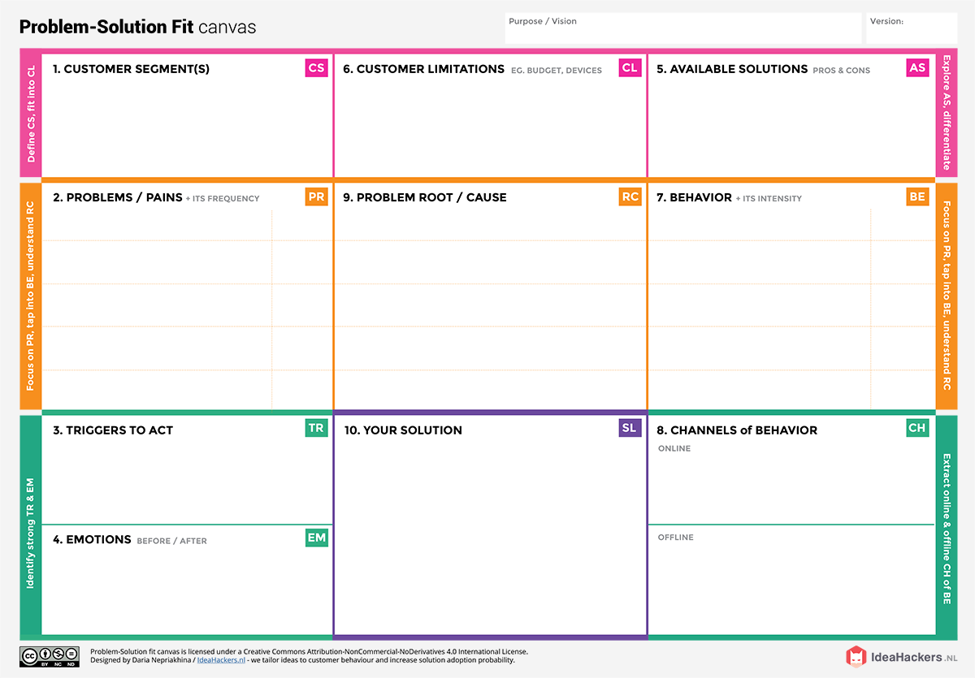
Farmers who are trying to protect their crops are the customers.
Adoption cost is high for security
concerns.
Customer is not aware of the Iot
in agriculture.
CCTV camera installed to monitor the crops
Web application can be used for maintenance of crops
Irrigation is not done properly
Crops are not maintained properly.
Difficult to monitor and control
Lack of protection of crops from
Wild animals, birds, pests
Lack of knowledge about the application.
Due to temperature, climate, soil quality which causes destruction in crops.
Due to less productivity, farmers are affected with their profit.
PH value, light intensity creates serious cause of environment
Takes more time in cropland
For an existing solution, searching for an alternate solution.
Placed in rural area where network is not proper for fast transmission speed.
Educating farmers about the latest technologies.
Opportunities to be created to uplift people from poverty.
“IOT based smart crop protection system for agriculture”
Farmers grow more food on less land by protection from weeds and productivity is increased per hectare.
Data is send to farmers through application to know about farms.
Frustrations created due to insufficient production of crops, heavy workload.
Easier to follow the latest technology and reduce costs.
Giving awareness on application
of the device among farmers.

